Slide 1
Overview of the Proposed Pan-Canadian Trust Framework (PCTF)
Consultation Deck
For Discussion Purposes Only
2018-12-11

Slide 2
Characteristics of the PCTF
A simple and integrative framework that is easy to understand yet capable of being applied in a complex environment
Technology-agnostic: provides flexibility and logical precision in assessing the trustworthiness of digital identity solutions and digital identity providers
Complements existing frameworks (security, privacy, service delivery, etc.)
Provides clear links to applicable policy, regulation, and legislation (by defining conformance criteria that can be easily mapped)
Normalizes (standardizes) key processes and capabilities to enable cross-sector collaboration and ecosystem development

Slide 3
Trusted Digital Representations and Trusted Processes
Currently the PCTF is composed of:
3 trusted digital representations
24 atomic trusted processes
Atomic trusted processes can be grouped together to form various compound trusted processes such as:
Identity Assurance
Credential Assurance
Notification and Consent
The PCTF is extensible and interoperable:
additional trusted processes can be added as required
the trusted processes can be mapped to Vectors of Trust (VoT)

Slide 4
Foundational Identity Versus Functional Identity
PTs, IRCC, etc.
Public Sector
Foundational Identity
All Federation Members
Pan-Canadian Trust Framework
Public and
Private Sector
Functional Identity

Slide 5
Trusted Digital Representations
Trusted Digital Identity (Person)
Trusted Digital Identity (Organization)
Verified Relationship

Slide 6
Trusted Process Model
A trusted process is an activity (or set of activities) that results in a state transition in an object that can be relied on by other trusted processes.
Object Input State
Trusted Process
Object Output State
Conformance Criteria ensure process integrity
An output state that can be relied on as a ‘proof’ (or ‘verifiable claim’) by others
Formalizing (and standardizing) the trusted processes, the input states, the output states, and the conformance criteria, is the essence of defining the trust framework!

Slide 7
Atomic Trusted Processes
Identity Resolution
Credential Suspension
Identity Verification
Request Consent
Identity Establishment
Credential Recovery
Liveness and Fraud Detection
Persist Consent
Identity Validation
Credential Maintenance
Identity-Credential Binding
Consent Maintenance
Identity Maintenance
Credential Revocation
Identity Linking
Review Consent
Credential Issuance
Authentication
Session Initiation
Validate Authorization for Consent
Consent Notification
Credential Authentication
Authentication
Session Termination
Formulate Notification Requirements
Signature

Slide 8
Compound Trusted Process: Identity Assurance
Identity Assurance
Non-Unique Identity Information
Identity Resolution
Unique Identity Information
No Authoritative Record
Identity Establishment
Authoritative Record
Unconfirmed Identity Information
Identity Validation
Confirmed Identity Information
Evidence of Identity
Proof of Identity
Unattributed Claims
Identity Verification
Attributed Claims
Non-Current Identity Information
Identity Maintenance
Current Identity Information
Not Checked
Liveness and Fraud Detection
Liveness and Fraud Checked
Unbound Credential
Identity-Credential Binding
Bound Credential
Unlinked Identifier
Identity Linking
Linked Identifier

Slide 9
Compound Trusted Process: Credential Assurance
Credential Assurance
No Credential
Credential Issuance
Issued Credential
Issued Credential
Credential Authentication
Authenticated Credential
Issued Credential
Credential Suspension
Inactive Credential
Unknown Actor
Authenticated User
Inactive Credential
Credential Recovery
Issued Credential
Inactive Credential
Credential Maintenance
Issued Credential
Issued Credential
Credential Revocation
Revoked Credential
No Session
Authentication Session Initiation
Authenticated Session
Authenticated Session
Authentication Session Termination
No Session

Slide 10
Compound Trusted Process: Notification and Consent
Notification and Consent
Presumed Authorization
Validate Authorization for Consent
Validated Authorization
No Notice
Formulate Notification Requirements
Notice Provided
No Consent
Request Consent
Consent
No Permission
Permission
One-Time Consent
Persist Consent
Ongoing Consent
Consent
Consent Maintenance
Updated Consent
Consent
Review Consent
Reviewed Consent
No Notification
Consent Notification
Notification Issued

Slide 11
Trusted Digital Identity (Person)
Trusted Digital Identity (Person)
Identity Assurance
Credential Assurance
Notification and Consent
Trusted Supporting Infrastructure (see detail on later slide)

Slide 12
Trusted Digital Identity (Person) – a set of trusted process outputs
A trusted digital Identity can be conceptualized as a set of trusted process outputs (or proofs) that are independent of conveyance method.
Depending on the ecosystem, some of these trusted processes may be carried out by multiple parties at different points in time.
Unique Identity Information
Bound Credential
Validated Authorization
Authoritative Record
Issued Credential
Notice Provided
Confirmed Identity Information
Authenticated Credential
Consent
Attributed Claims
Authenticated Session
Ongoing Consent
Current Identity Information
Updated Consent
Liveness and Fraud Checked
Reviewed Consent
Notification Issued

Slide 13
Trusted Supporting Infrastructure
Digital Service Delivery
Federation Interoperability - Standards and Specifications
Service Level Agreements
User Needs and Experience
Business (e.g., PCIM Standards)
Communications
Technical (e.g., SAML, OIDC)
Privacy and Security
PCTF Endorsements
Privacy Impact Assessment
Jurisdictional Endorsement
Security Assessment and Authorization
Pan-Canadian Endorsement
Audit and Logging
Service Authorization and Access
Auditing
Service Authorization
Access Control
Logging
Resource Management
All Federation Members
Relying Parties only

Slide 14
Other Compound Trusted Processes
Identity Creation
Identity Confirmation
Binding
Notification and Consent
Credential Creation
Credential Authentication
Linking
Identity Registration
Service Registration
Trusted Digital Identity Creation
Service Enrolment

Slide 15
The Identity Confirmation Compound Trusted Process
Identity Confirmation
Identity Validation
Identity Maintenance
Liveness and Fraud Detection
Identity Verification

Slide 16
Trusted Processes can be carried out by multiple parties
(e.g., MyAlberta Digital Identity being consumed by ESDC)
No. | Trusted Process | LOA/Vector Requirement | Trusted Digital Identity Provider | Credential Service Provider | Relying Party
1 | Identity Resolution | … | MADI |  | ESDC
2 | Identity Establishment | 3 | MADI |  | ESDC
3 | Identity Validation | 3 | MADI
4 | Identity Verification | 3 | MADI |  | ESDC
5 | Identity Maintenance | 3 | MADI |  | ESDC
6 | Liveness and Fraud Detection | … | MADI |  | ESDC
7 | Identity-Credential Binding | … | MADI
8 | Identity Linking | … |  |  | ESDC
9 | Credential Issuance | 2 | MADI
10 | Credential Authentication | 2 | MADI
11 | Credential Suspension | 2 | MADI
12 | Credential Recovery | 2 | MADI
13 | Credential Maintenance | 2 | MADI
14 | Credential Revocation | 2 | MADI
15 | Authentication Session Initiation | 2 | MADI
16 | Authentication Session Termination | 2 | MADI
17 | Validate Authorization for Consent | … | MADI |  | ESDC
18 | Formulate Notification Requirements | … | MADI |  | ESDC
19 | Request Consent | … | MADI |  | ESDC
20 | Persist Consent | … | MADI |  | ESDC
21 | Consent Maintenance | … | MADI |  | ESDC
22 | Review Consent | … | MADI |  | ESDC
23 | Consent Notification | … | MADI |  | ESDC
24 | Signature | ...

Slide 17
Trusted Digital Identity Provider
Trusted Digital Identity Creation
Credential Creation
Credential Issuance
Identity Proofing
Identity Creation
Identity Resolution
Identity Establishment
Credential Authentication
Credential Authentication
Credential Suspension
Credential Recovery
Credential Maintenance
Credential Revocation
Authentication Session Initiation
Authentication Session Termination
In scope for the PCTF assessment process
Identity Registration
Identity Confirmation
Identity Validation
Identity Maintenance
Liveness and Fraud Detection
Identity Verification
Notification and Consent
Validate Authorization for Consent
Formulate Notification Requirements
Request Consent
Persist Consent
Consent Maintenance
Review Consent
Consent Notification
Binding
Identity-Credential Binding
Trusted Supporting Infrastructure

Slide 18
Relying Party
Service Enrolment (without a Trusted Digital Identity)
Credential Creation
Credential Issuance
Identity Proofing
Identity Creation
Identity Resolution
Identity Establishment
Credential Authentication
Credential Authentication
Credential Suspension
Credential Recovery
Credential Maintenance
Credential Revocation
Authentication Session Initiation
Authentication Session Termination
Identity Registration
Identity Confirmation
Identity Validation
Identity Maintenance
Liveness and Fraud Detection
Identity Verification
Notification and Consent
Validate Authorization for Consent
Formulate Notification Requirements
Request Consent
Persist Consent
Consent Maintenance
Review Consent
Consent Notification
Binding
Identity-Credential Binding
Trusted Supporting Infrastructure

Slide 19
Relying Party
Service Enrolment (with a Trusted Digital Identity)
Identity Proofing
Identity Creation
Identity Resolution
Identity Establishment
Service Registration
Identity Confirmation
Identity Maintenance
Liveness and Fraud Detection
Identity Verification
Notification and Consent
Validate Authorization for Consent
Formulate Notification Requirements
Request Consent
Persist Consent
Consent Maintenance
Review Consent
Consent Notification
Linking
Identity Linking
Trusted Supporting Infrastructure

Slide 20
Trusted Processes and Conveyance
Trusted process outputs (i.e., proofs) are independent of conveyance model. The proofs (output states) can be conveyed using a traditional/centralized model (e.g., a trusted third party) or a decentralized model (e.g., a distributed ledger, a blockchain) – or both.
Conveying a proof from one party to another party
Traditional/Centralized Model
Party A
Party B
Input State
Trusted Process
Output State
Trusted Third Party
Input State
Trusted Process
Output State
Decentralized Model
Party A
Party B
Input State
Trusted Process
Output State
Distributed Ledger; Blockchain
Input State
Trusted Process
Output State

Slide 21
Vectors of Trust
A proposed IETF standard (RFC 8485, October 2018)
Currently consists of 4 components:
Identity Proofing (P): describes how likely it is that a given digital identity transaction corresponds to a particular, real-world identity subject
Primary Credential Usage (C): defines how strongly the primary credential can be verified by the TDIP
Primary Credential Management (M): conveys information about the expected lifecycle of the primary credential in use, including its binding, rotation, and revocation
Assertion Presentation (A): defines how well the TDI can be communicated across the network without information leaking to unintended parties and without spoofing

Slide 22
Entities and Relationships
Internal and External Many-to-Many Relationships
Person
Organization
0:n
0:n
0:n
Using an Associative Entity
Person
Relationship
Organization
0:n
0:n

Slide 23


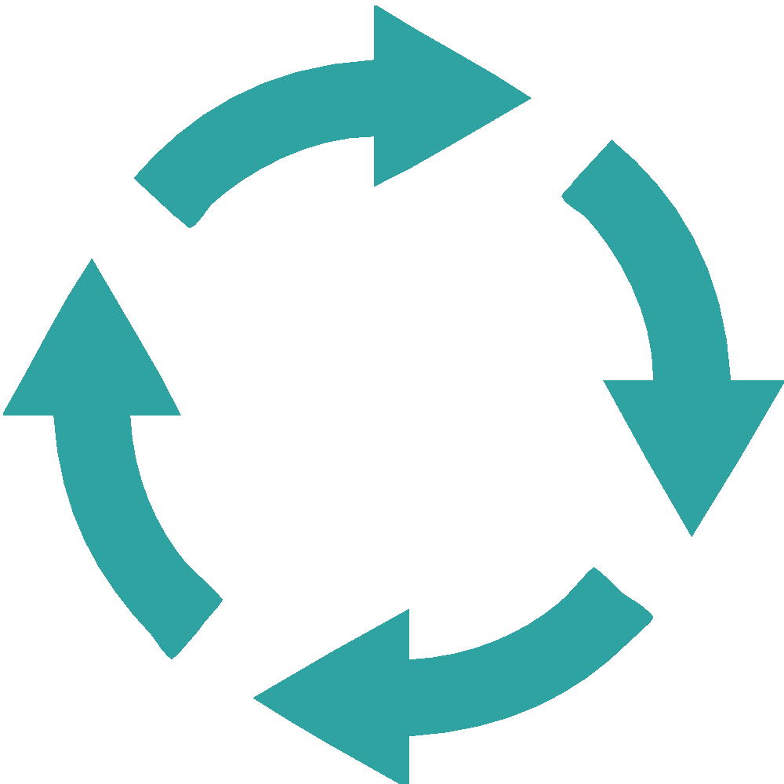


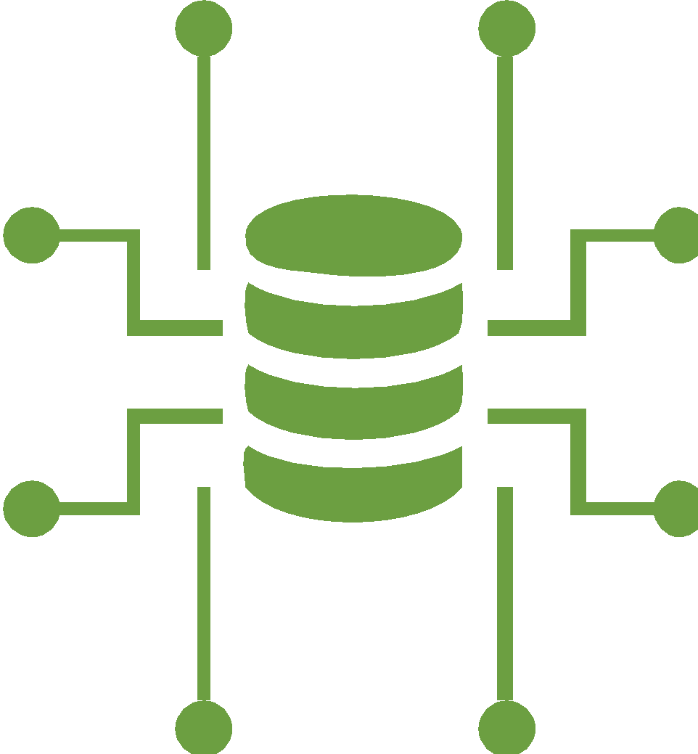


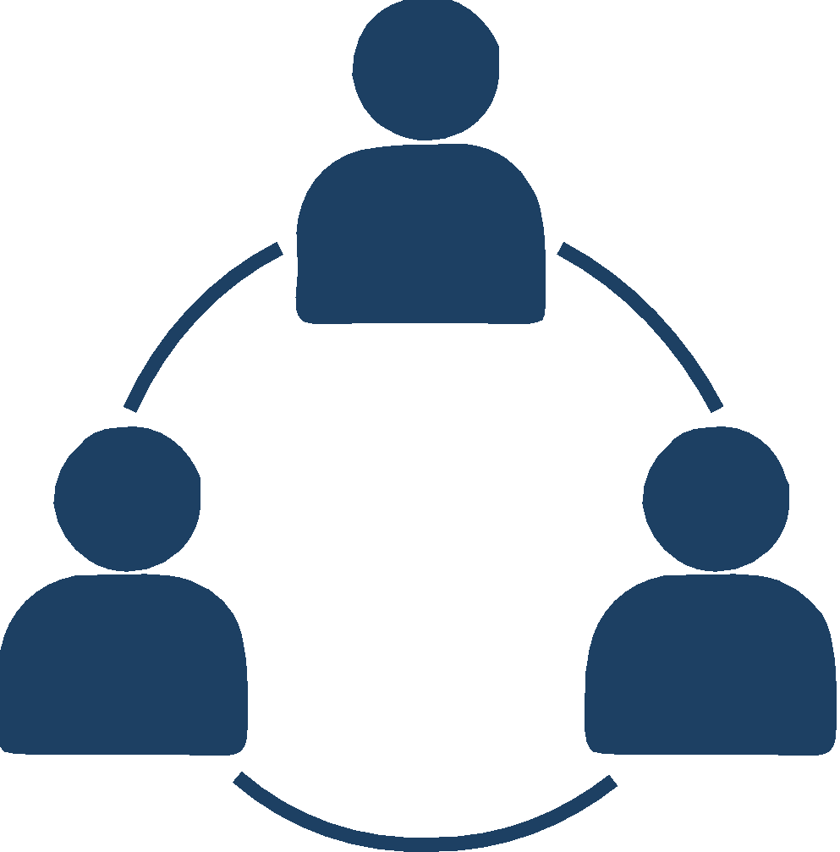
Government of Canada Digital Standards
A Set of Guiding Principles
Design with users
Build in accessibility from the start
Iterate and improve frequently
Empower staff to deliver better services
Work in the open by default
Be good data stewards
Use open standards and solutions
Design ethical services
Address security and privacy risks
Collaborate widely

